Slide 1
Fuel economy
CAPSTONE PROJECT
Presented By:
Barath Kumar . A,
9513- Jayaraj Annapackiam CSI College Of Engineering,
B.E Mechanical Engineering.

Slide 2
OUTLINE
Problem Statement
Proposed System/Solution
System Development Approach
Algorithm & Deployment
Result
Conclusion
Future Scope
References

Slide 3
Problem Statement
Problem Statement: Design and conduct a comprehensive fuel economy analysis for a fleet of vehicles, considering various parameters such as vehicle type, driving conditions, maintenance practices, and fuel types. The analysis should aim to identify factors that significantly impact fuel efficiency and propose actionable recommendations to improve overall fuel economy while balancing performance and cost-effectiveness.
Key Components of the Analysis:
Data Collection: Gather data on vehicle specifications, fuel consumption rates, driving patterns, maintenance schedules, and fuel prices.
Data Analysis: Analyze the collected data to identify correlations between different variables and fuel efficiency. Utilize statistical methods and visualization techniques to gain insights.
Factor Identification: Identify key factors that influence fuel economy, such as vehicle weight, engine size, driving speed, route characteristics, tire pressure, and maintenance practices.
Scenario Analysis: Conduct scenario-based analyses to understand the impact of different driving conditions (e.g., city driving, highway driving, stop-and-go traffic) on fuel economy.
Recommendations: Based on the analysis results, propose actionable recommendations to improve fuel economy, such as optimizing vehicle routes, implementing eco-driving techniques, adopting fuel-efficient technologies, and scheduling regular maintenance checks.
Cost-Benefit Analysis: Evaluate the cost-effectiveness of recommended measures by comparing potential fuel savings with implementation costs and other associated benefits

Slide 4
Proposed Solution
Data Collection:
Gather data on vehicle specifications (make, model, year), fuel consumption rates (miles per gallon or liters per 100 kilometers), driving patterns (urban, highway), maintenance schedules (regular maintenance, tune-ups), and fuel prices.
Obtain information on environmental factors like temperature, altitude, and road conditions that may affect fuel economy.
Data Analysis:
Use statistical analysis techniques to identify correlations between variables such as vehicle type, driving conditions, maintenance practices, and fuel consumption.
Visualize data using graphs and charts to highlight trends and patterns.
Model Development:
Develop mathematical models or simulations to predict fuel consumption based on the identified factors.
Validate the models using real-world data and adjust parameters as needed.
Scenario Analysis:
Conduct scenario-based analyses to simulate different driving conditions (e.g., city driving, highway driving, heavy traffic) and their effects on fuel economy.
Evaluate the impact of variables like vehicle speed, load capacity, and route selection on fuel efficiency.
Implementation Plan:
Collaborate with vehicle manufacturers, fleet operators, and regulatory bodies to implement fuel-efficient technologies and practices.

Slide 5
System Approach
A systematic approach to fuel economy analysis involves breaking down the problem into manageable steps, utilizing data-driven methods, and incorporating feedback loops for continuous improvement. Here's a system approach to fuel economy analysis:
Define Objectives and Scope.
Data Collection and Management
Analysis Framework
Factor Identification and Prioritization
Model Development and Validation
Scenario Analysis and Optimization
Recommendations and Action Plans
Monitoring and Feedback
Reporting and Communication
Continuous Improvement.

Slide 6
Algorithm & Deployment
Fuel Economy Algorithm
Data Collection and Preparation:
Gather data on vehicle specifications (weight, engine type, year), driving conditions ,maintenance records, fuel consumption rates, and external factors (weather, road conditions).
Preprocess the data by handling missing values, encoding categorical variables, and scaling numerical features.
Feature Engineering:
Extract relevant features such as vehicle weight, engine size, aerodynamics, tire pressure, driving speed, traffic patterns, and weather conditions.
Create additional features like average speed, idling time, and load factors to capture more insights.
Training and Validation:
Split the dataset into training and validation sets.
Train the selected model using the training data and validate its performance using metrics like mean absolute error (MAE), mean squared error (MSE), and R-squared.
Optimization and Fine-Tuning:
Optimize hyper parameters using techniques like grid search or random search to improve model performance.
Perform feature selection or dimensionality reduction if needed to enhance model interpretability and efficiency.

Slide 7
Deployment of Fuel Economy
Deployment Environment:
Choose a deployment environment based on the use case, such as an on-board vehicle system, cloud platform, edge device, or web application.
Consider factors like scalability, real-time processing capabilities, and data connectivity.
Model Integration:
Serialize and save the trained model using a suitable format (e.g., pickle, joblib) for deployment.
Integrate the model into the deployment environment using programming languages like Python, Java, or C++.
Real-time Prediction:
Implement real-time prediction capabilities in the deployed system to handle incoming data streams.
Ensure efficient processing and response times for timely fuel economy analysis and recommendations.
User Interface (UI):
Develop a user interface (UI) if the system is designed for human interaction.
Design an intuitive interface to input data, display analysis results, and provide actionable insights.
Monitoring and Maintenance:
Implement monitoring mechanisms to track system performance, model accuracy, and data quality over time.
Set up alerts for anomalies or performance degradation and conduct regular maintenance to update models, dependencies, and security measures.

Slide 8
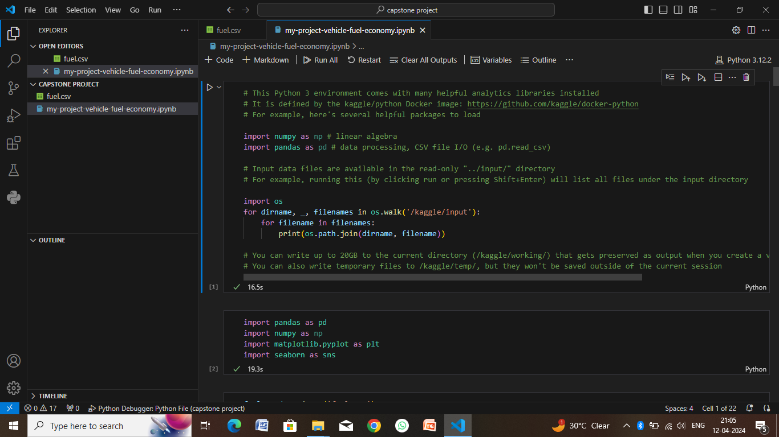
Result

Slide 9
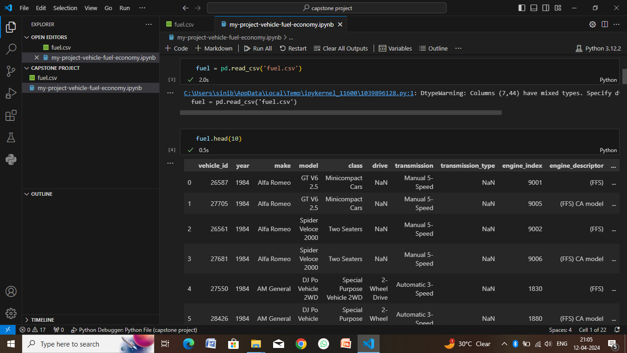

Slide 10
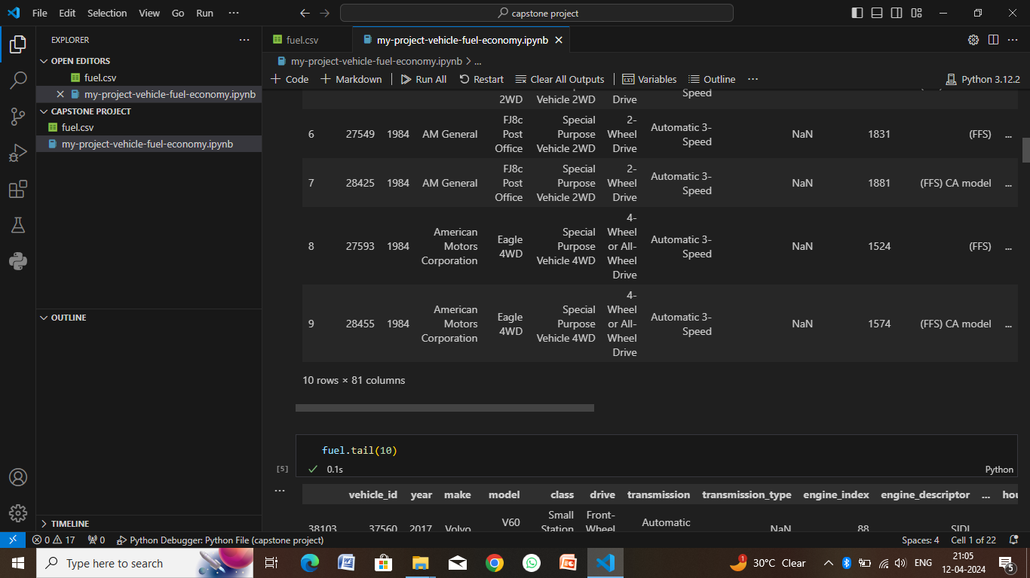

Slide 11
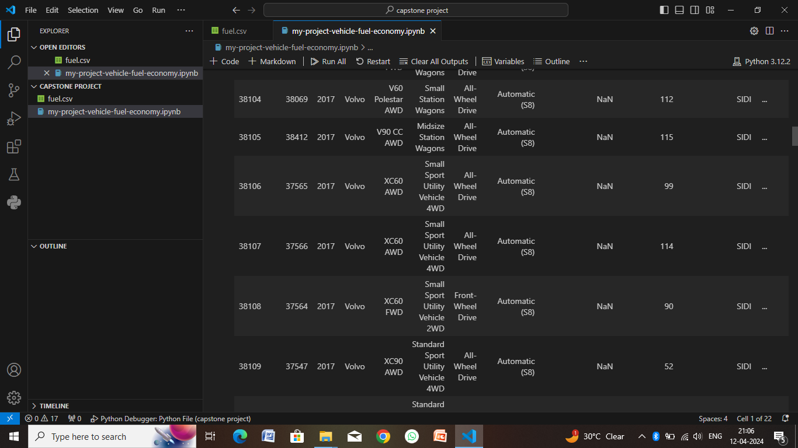

Slide 12
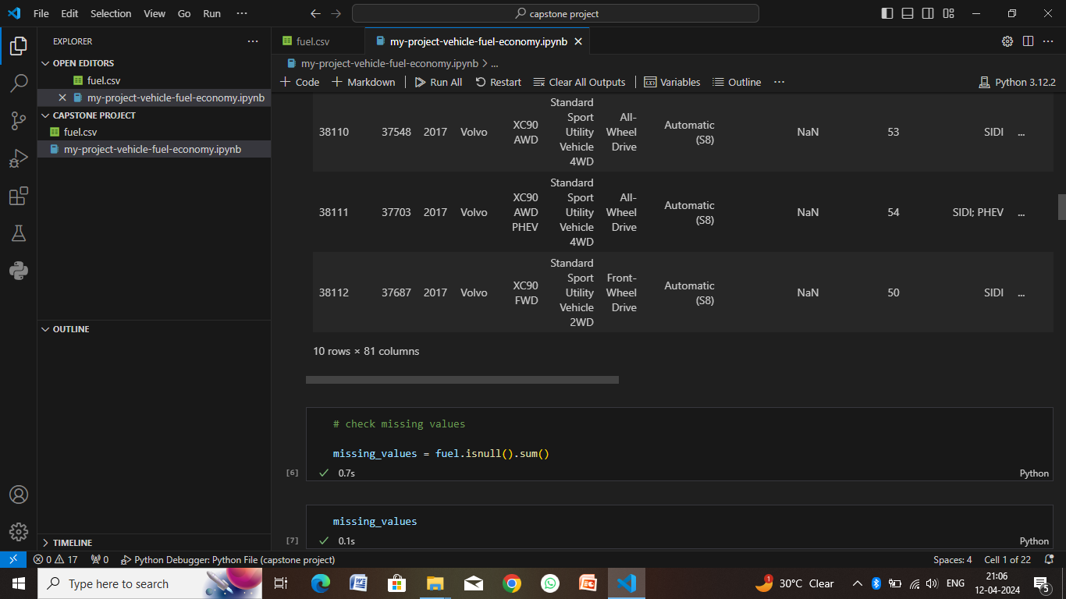

Slide 13
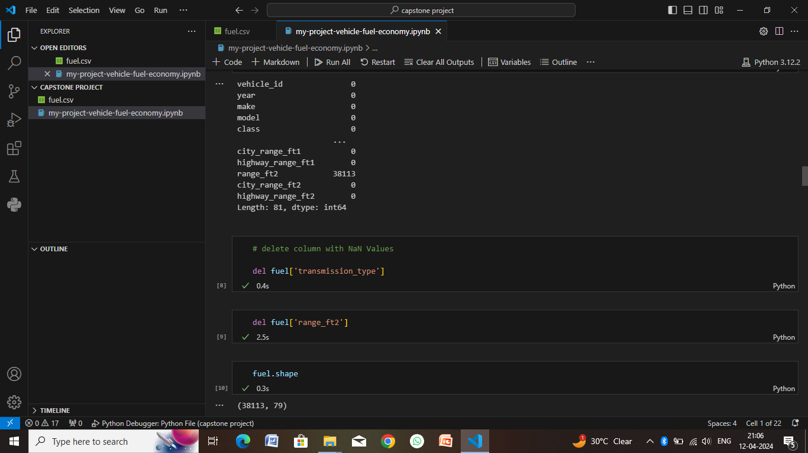

Slide 14
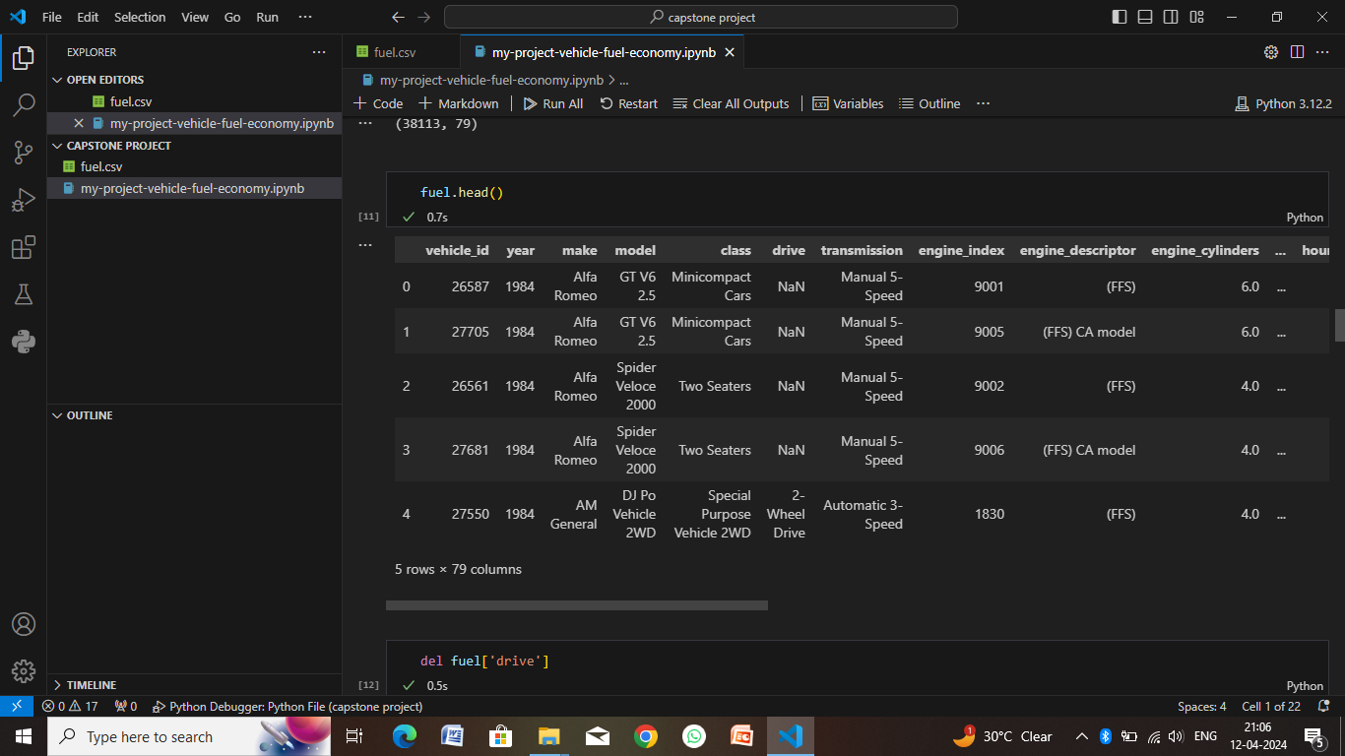

Slide 15
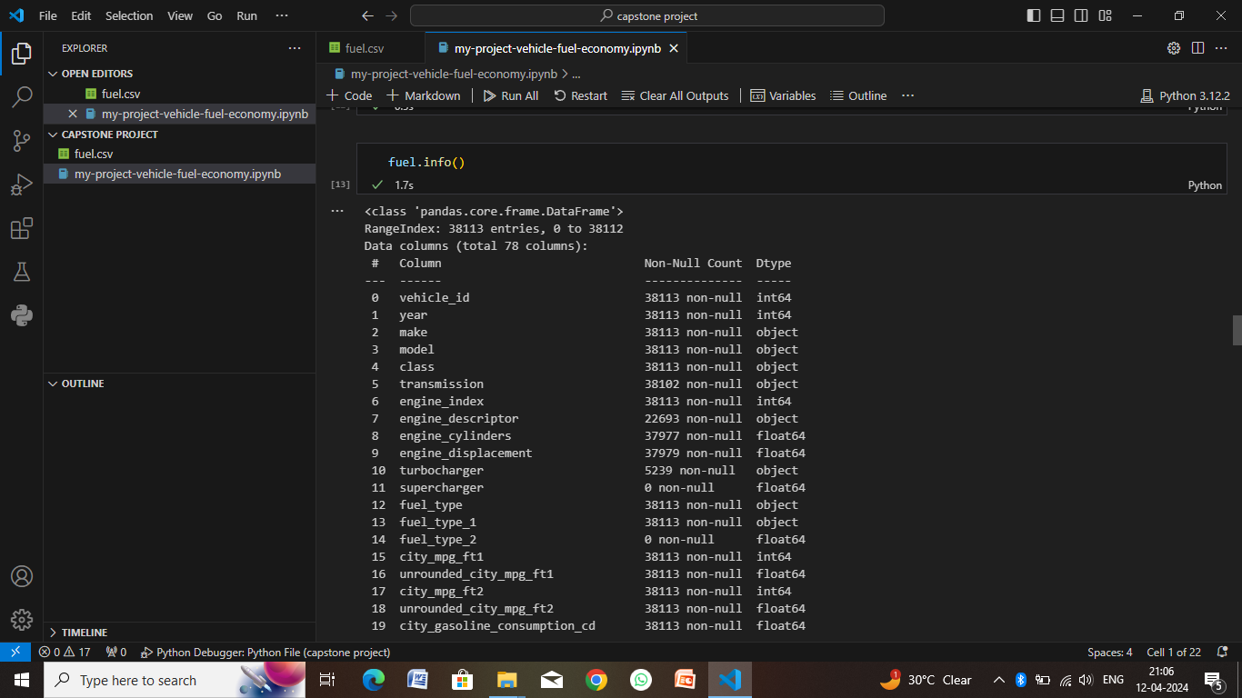

Slide 16
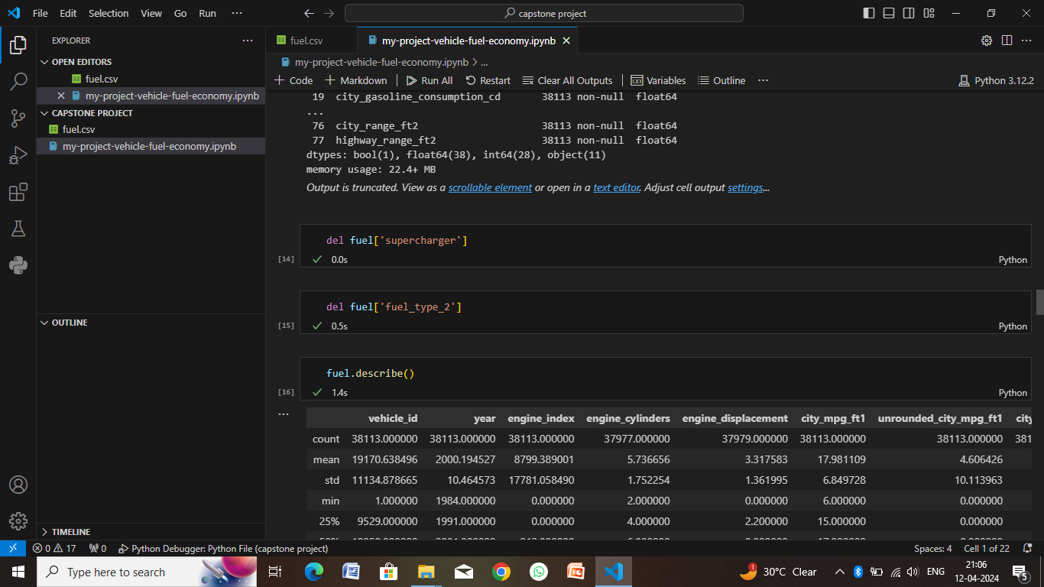

Slide 17
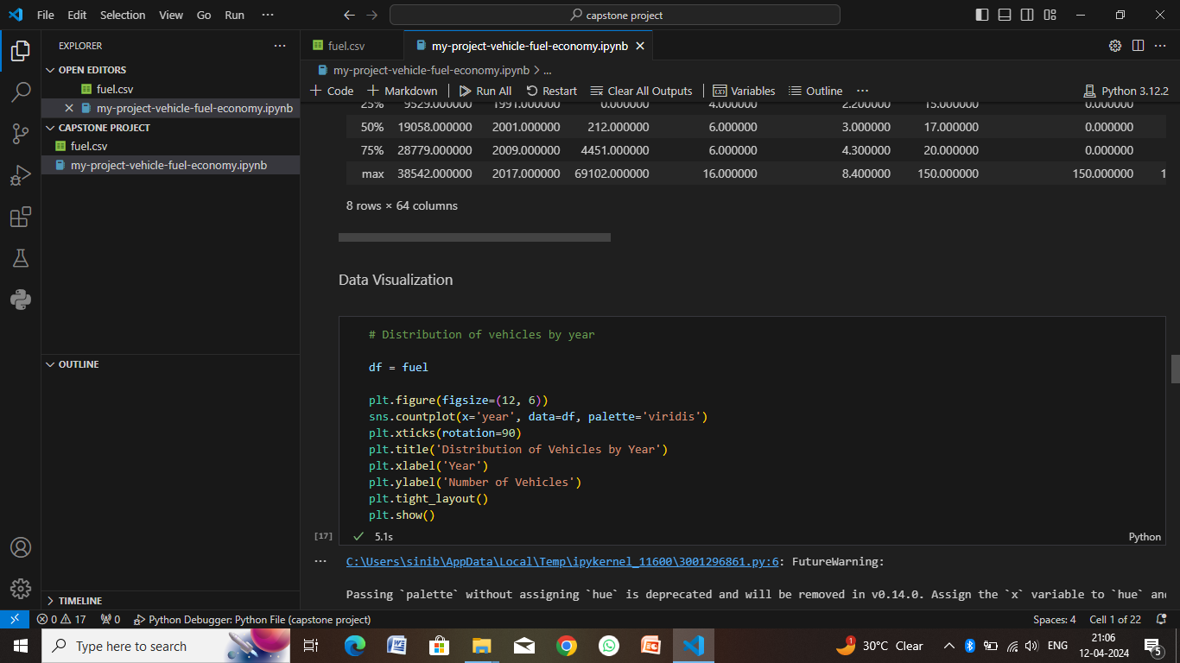

Slide 18
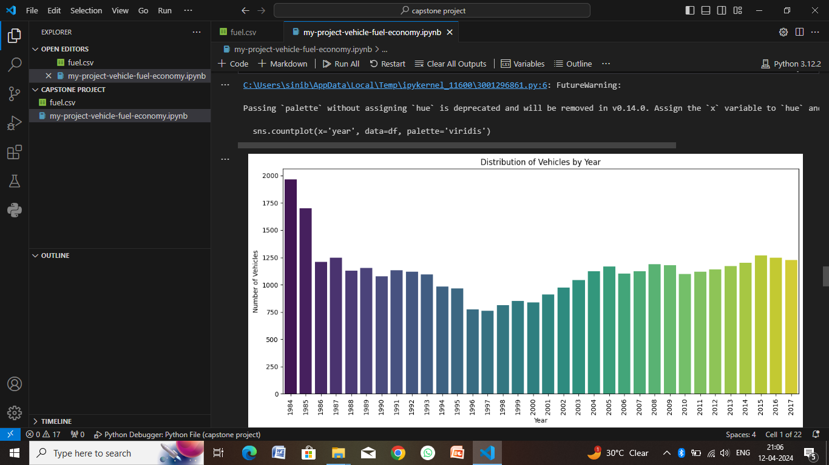

Slide 19
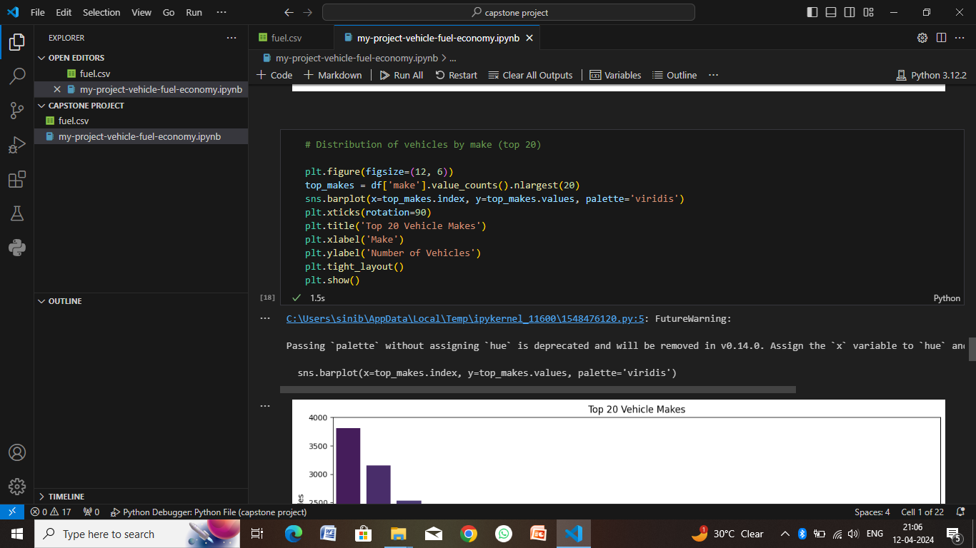

Slide 20
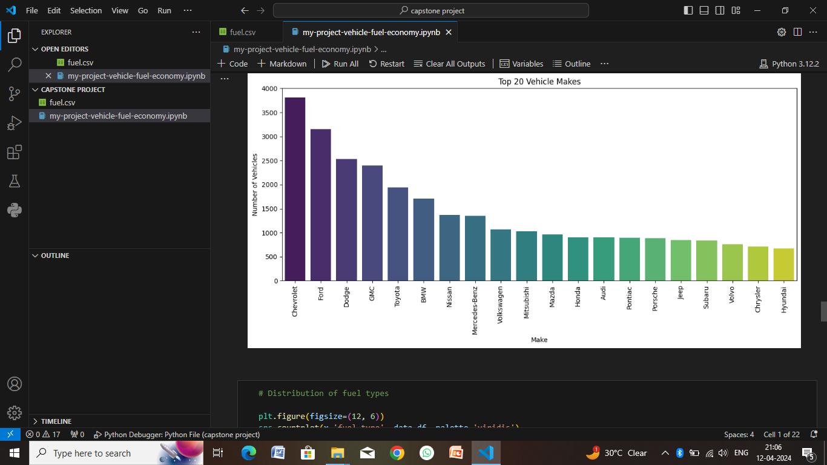

Slide 21
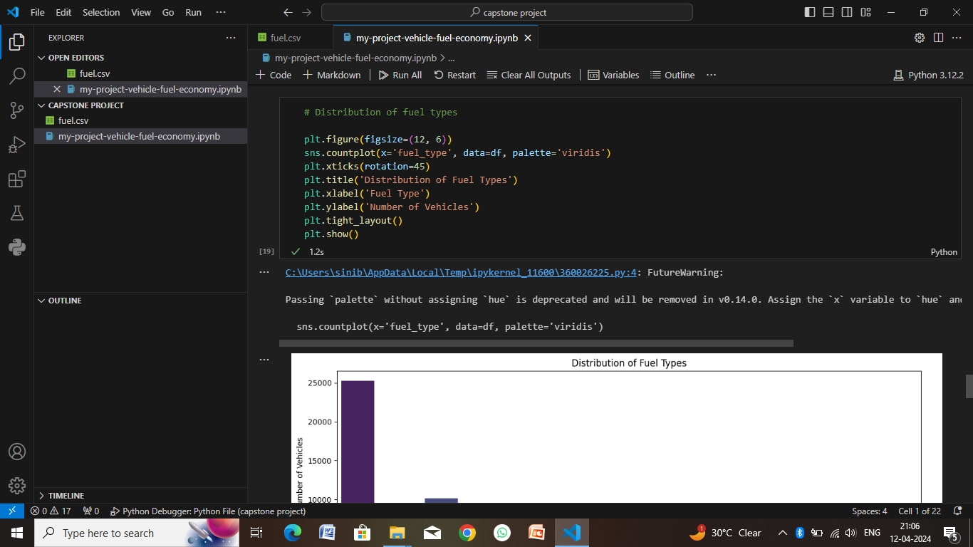

Slide 22
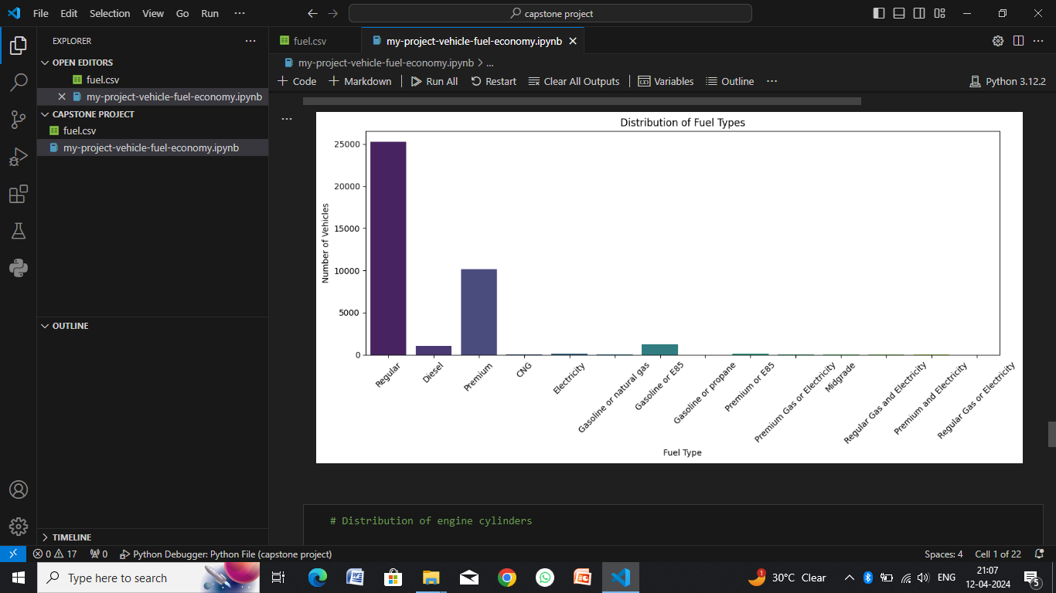

Slide 23
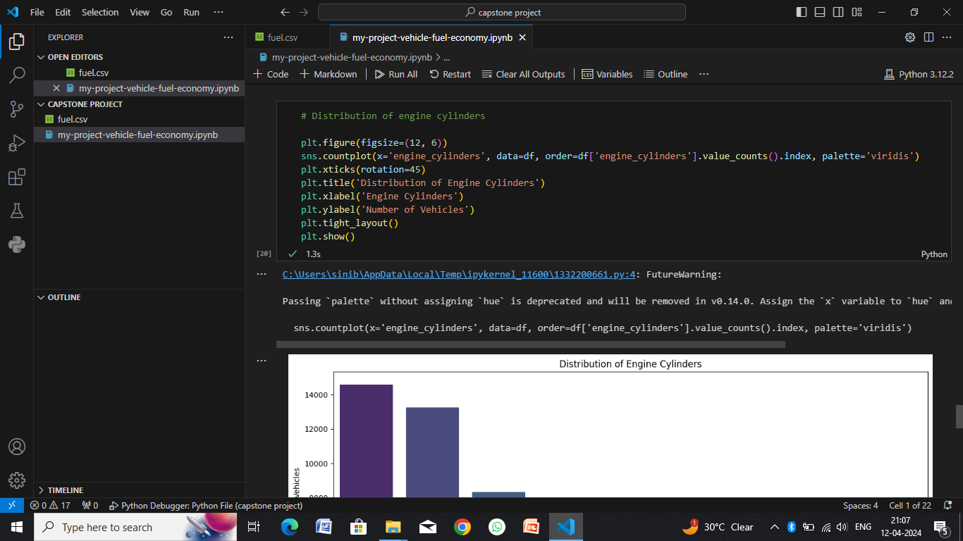

Slide 24
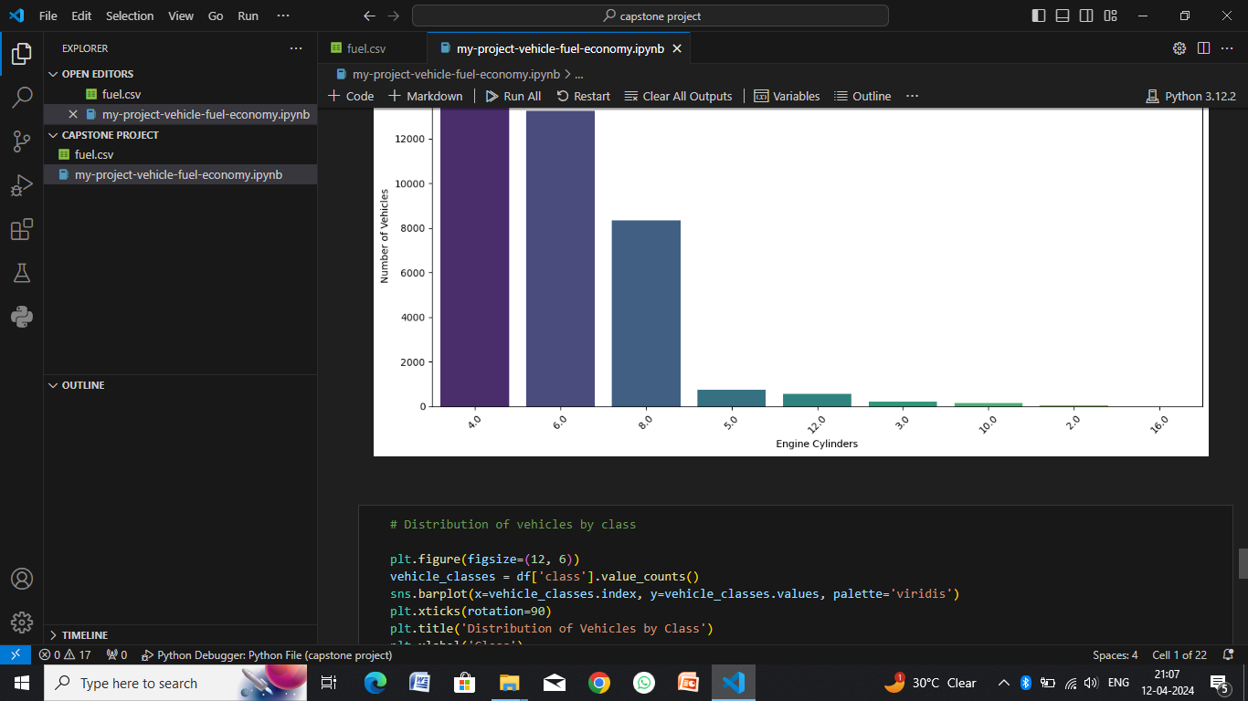

Slide 25
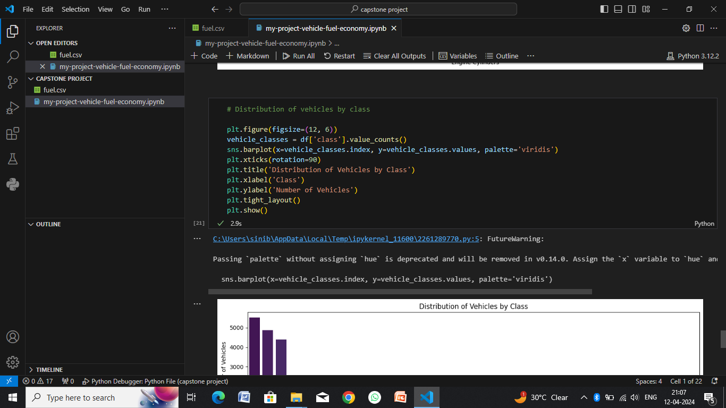

Slide 26
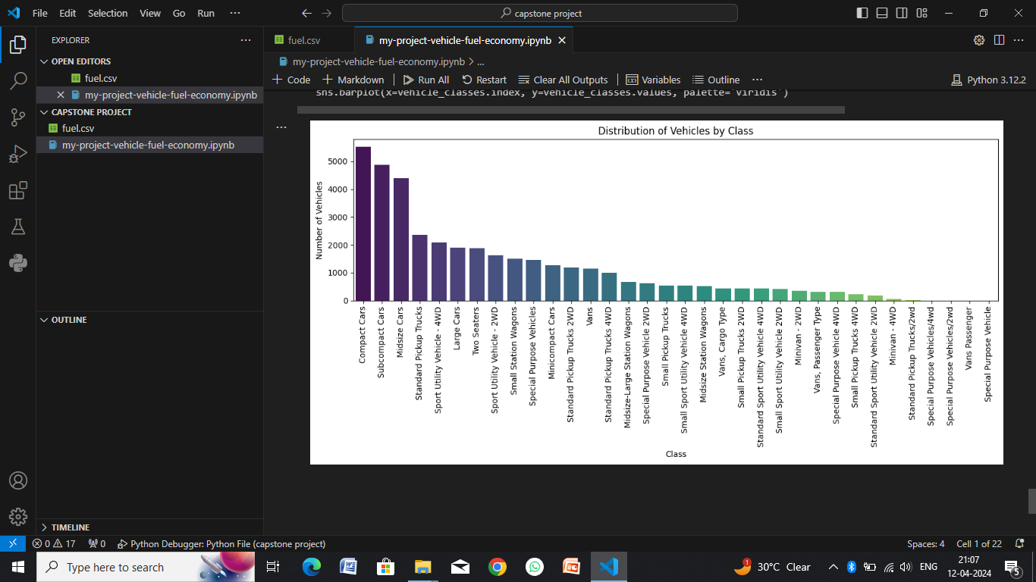

Slide 27
Conclusion
In conclusion, the fuel economy analysis has provided valuable insights into factors influencing fuel efficiency, actionable recommendations for optimization, and potential pathways for future advancements. By implementing the recommended strategies and embracing continuous improvement practices, organizations can achieve significant fuel savings, reduce environmental impact, and enhance overall operational efficiency in the transportation sector.
Actionable Insights:
Optimization Opportunities
Cost-Effective Strategies
Operational Recommendations
Future Directions:
Research Opportunities
Technology Advancements
Industry Trends

Slide 28
Future scope
The future scope of fuel economy encompasses a range of technological advancements, policy initiatives, and industry trends that will shape the landscape of transportation and energy efficiency. Here are some key areas of future development and innovation in fuel economy:
1. Advanced Power train Technologies
2. Vehicle Light weighting and Aerodynamics
3. Intelligent Transportation Systems (ITS)
4. Sustainable Fuels and Energy Sources
5. Data Analytics and Optimization
6. Regulatory and Policy Initiatives
7. Consumer Awareness and Behavior

Slide 29
References
Fuel Economy Guide by the U.S. Department of Energy (DOE): You can access the Fuel Economy Guide on the official website of the U.S. Department of Energy at fueleconomy.gov.
Global Fuel Economy Initiative (GFEI): Visit the official GFEI website at globalfueleconomy.org.
Advanced Technology Vehicle Guide by the Environmental Protection Agency (EPA): The EPA's Advanced Technology Vehicle Guide can be found on their official website at epa.gov/greenvehicles.
IEEE Transactions on Intelligent Transportation Systems: IEEE's Transactions on Intelligent Transportation Systems and related publications can be accessed through the IEEE Xplore Digital Library at ieeexplore.ieee.org. You may need institutional access or a subscription to view full articles.

Slide 30
THANK YOU

